Slide 1


Business Process Management
Overview
Notes:
Welcome back to the forth module of data science.

Slide 2
Agenda
01
02
03
History of bpm
definition
Basic concepts
04
05
06
Bpm profiles
Bpm lifecycle
Bpm stakeholders
07
08
Bpm vendors/customers
09
Bpm industry
BPM Acquisition

Slide 3
Agenda
10
11
12
Bpm advantages
Bpm barriers
Bpm framework
13
BpM Development Approach
14
BpM testing Approach
15
conclusion

Slide 4
History Of BPM

Slide 5
History Of BPM

Slide 6
Definition of BPM

Slide 7
Definition of BPM
Business Process Management is continuous optimization of existing manual process of an organization to model, implement, execute, control and monitor them in closed loop cycle.

Slide 8
Basic Concept

Slide 9
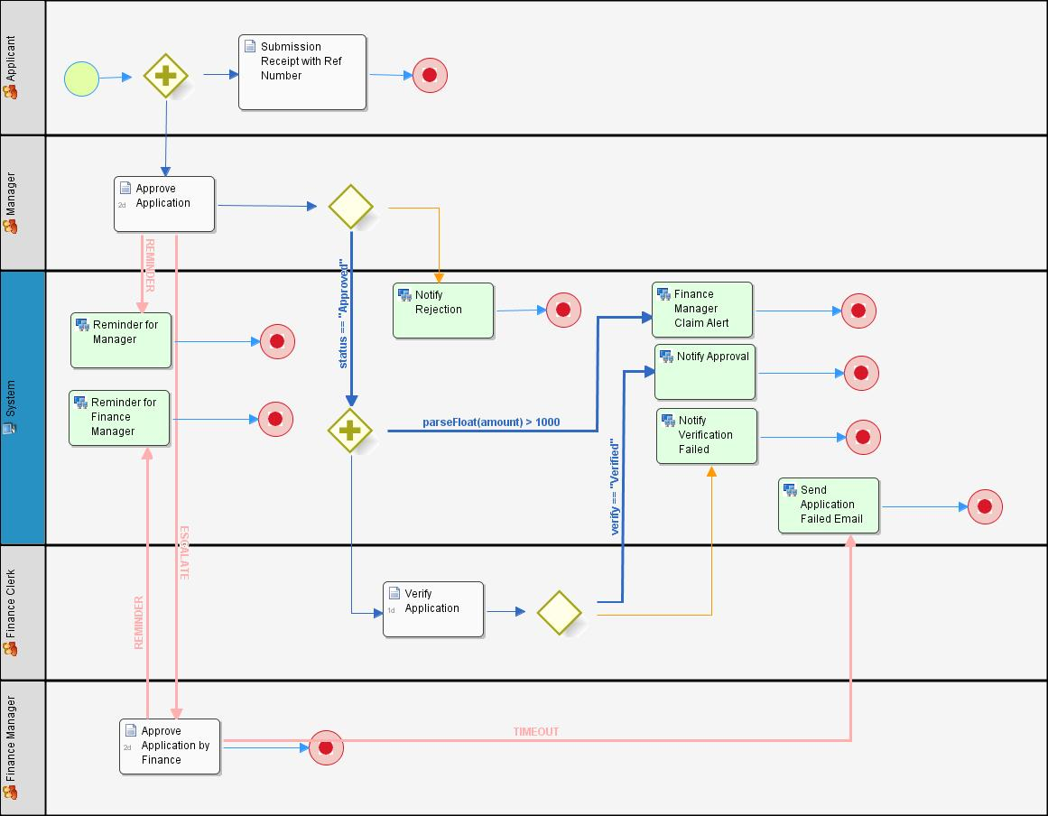
Basic Concept
Process
Activities
Roles
Participants

Slide 10
BPM Profiles

Slide 11
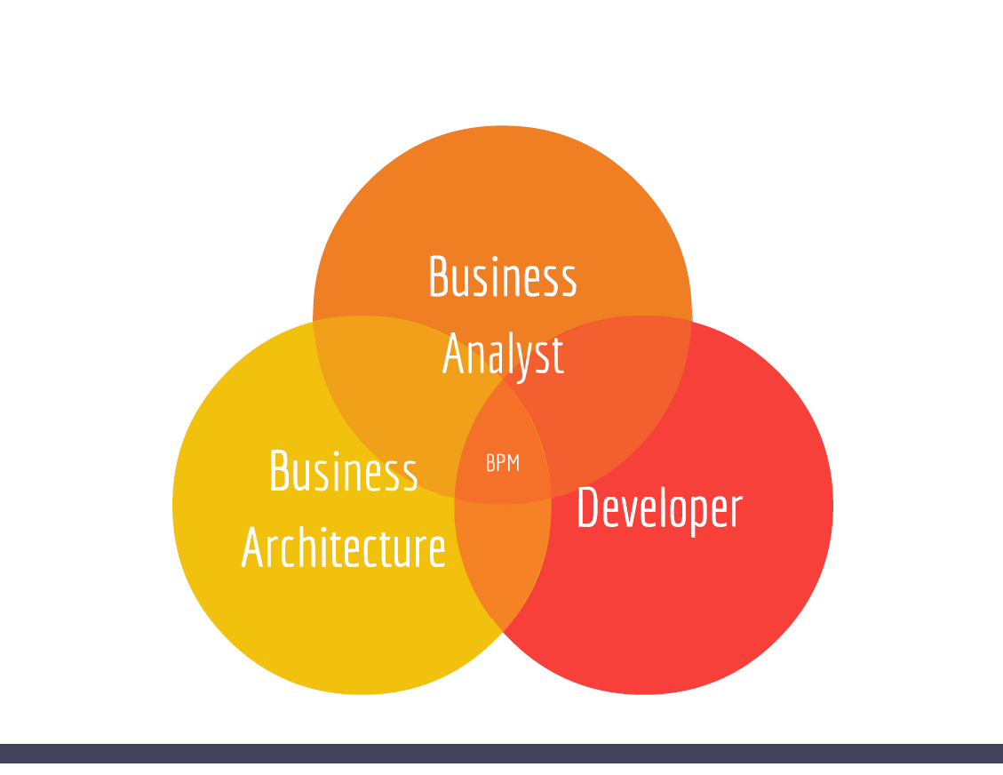
BPM Profiles

Slide 12
BPM LifeCycle

Slide 13
BPM LifeCycle

Slide 14
BPM Stakeholders

Slide 15
BPM Stakeholders

Slide 16
BPM Industry

Slide 17
BPM Industry

Slide 18
BPM Vendors

Slide 19
BPM Vendors

Slide 20
BPM Customers

Slide 21
BPM Customers

Slide 22
BPM Acquisitions

Slide 23
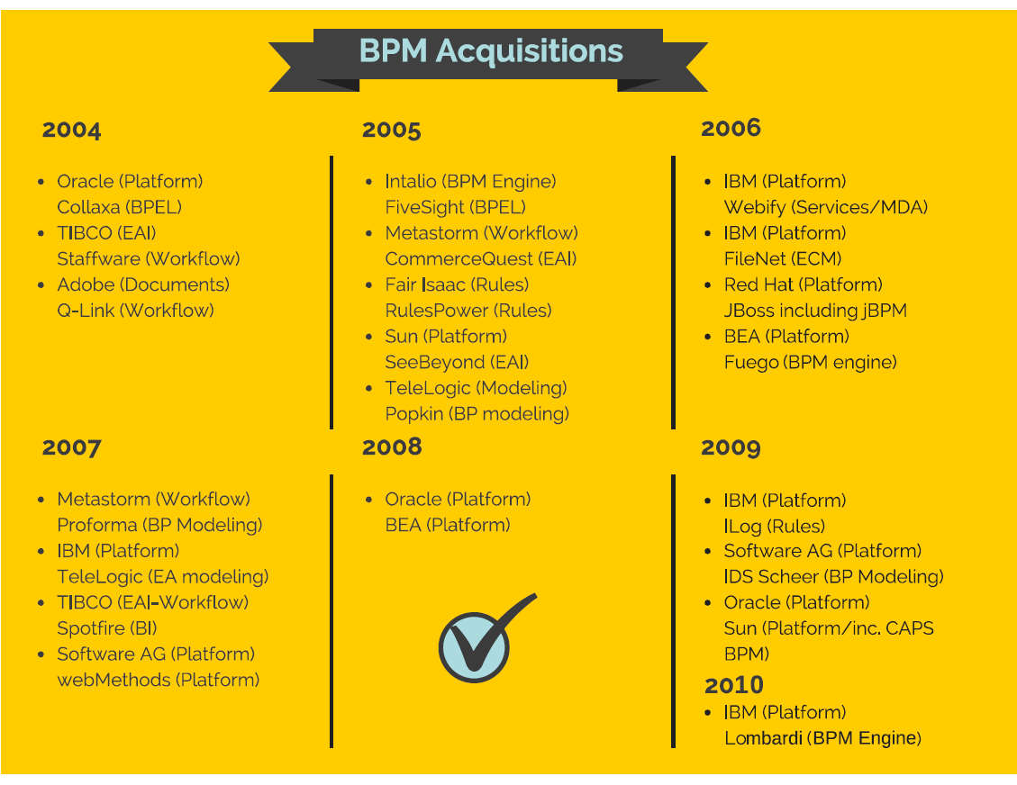
BPM Acquisitions

Slide 24
BPM Advantages

Slide 25
BPM Advantages

Slide 26
BPM Barriers

Slide 27
BPM Barriers

Slide 28
BPM Framework

Slide 29
BPM Framework

Slide 30
BPM Development
Approach

Slide 31
BPM Development Approach

Slide 32
BPM Testing
Approach

Slide 33
BPM Testing Approach

Slide 34
Conclusion

Slide 35

India : +91-7847955955
US : 1-800-216-8930 (TOLL FREE)
sales@intellipaat.com
24X7 Chat with our Course Advisor
Notes:
Thank you!

